Slide 1
EVENT EASE
Team Details:
Jaiveer Singh : 2310992104
Jasmeet Singh : 2310992108
Navya : 2310992164
Faculty Co-Ordinator : Dr. Kirandeep Singh
:
Chitkara University Institute of Engineering and Technology,
Chitkara University, Punjab

Slide 2
Table of Contents
Introduction
Problem Statement
Technical Details
Frontend
Backend
Project Flow
Key Features
Project Highlights
Conclusion

Slide 3
Introduction
Project Overview:
EventEase is a web-based application designed to simplify the process of event registration and management. It provides a user-friendly interface for both event organizers and participants, ensuring seamless handling of registrations and participant data.

Slide 4
Problem Statement
Event organizers often face challenges in efficiently managing participant registrations, tracking data, and presenting it in an accessible format.
EventEase solves these problems by providing:
A centralized platform for registration.
Automated storage and retrieval of participant details.
Easy access to organized data for event planners.
This solution reduces manual work, minimizes errors, and improves the overall experience for both organizers and participants.

Slide 5
Technical Details
Technologies Used:-
Frontend: HTML, CSS, JavaScript, Bootstrap.
Backend: Node.js (HTTP module).
Data Storage: JSON file for simple and quick access.

Slide 6
Frontend
.
HTML Structure-
Form for Registration:
Input fields for candidate details like name, age, roll number, and event class.
A submit button for registering candidates.
Table for Registered Candidates:
A responsive table to display a list of registered participants with their details.
Navigation Bar:
Links to navigate between different pages like Home, Register, and Registered Candidates.

Slide 7
2. CSS-
Design and Layout:
Used to style the forms and tables.
Color schemes, fonts, and layout adjustments for a user-friendly interface.
Animations for a smooth transition and engaging experience.

Slide 8
JavaScript-
Dynamic Content Handling:
Fetching data from the backend using the fetch() function.
Populating the table with student information dynamically.
Submitting form data to the backend via POST requests.

Slide 9
Backend
Server Setup:
http module: Creates a server to handle incoming requests.
fs module: Reads and writes data to a User.json file.
qs module: Parses form data sent in POST requests.
Request Handling:
GET Request: Fetches data from the User.json file and sends it as a response (for displaying all student data).
POST Request: Receives form data, stores it in User.json, and responds with a success page.

Slide 10
Data Storage:
Data is stored in a JSON file (User.json), where each new registration is appended.

Slide 11
Project Flow:
User fills the admission form.
Data sent to server via POST.
Server stores data in JSON file.
User redirected to success page.
Admin can view all student data using the GET request

Slide 12
Key Features
User-Friendly Design
Compelling Visuals
Responsive Design
Clear and Organized Content Layout
Interactive Data Display
Success Confirmation
Error Handling
Data Storage Integration
Backend Processing
Integrated Resource Links.

Slide 13
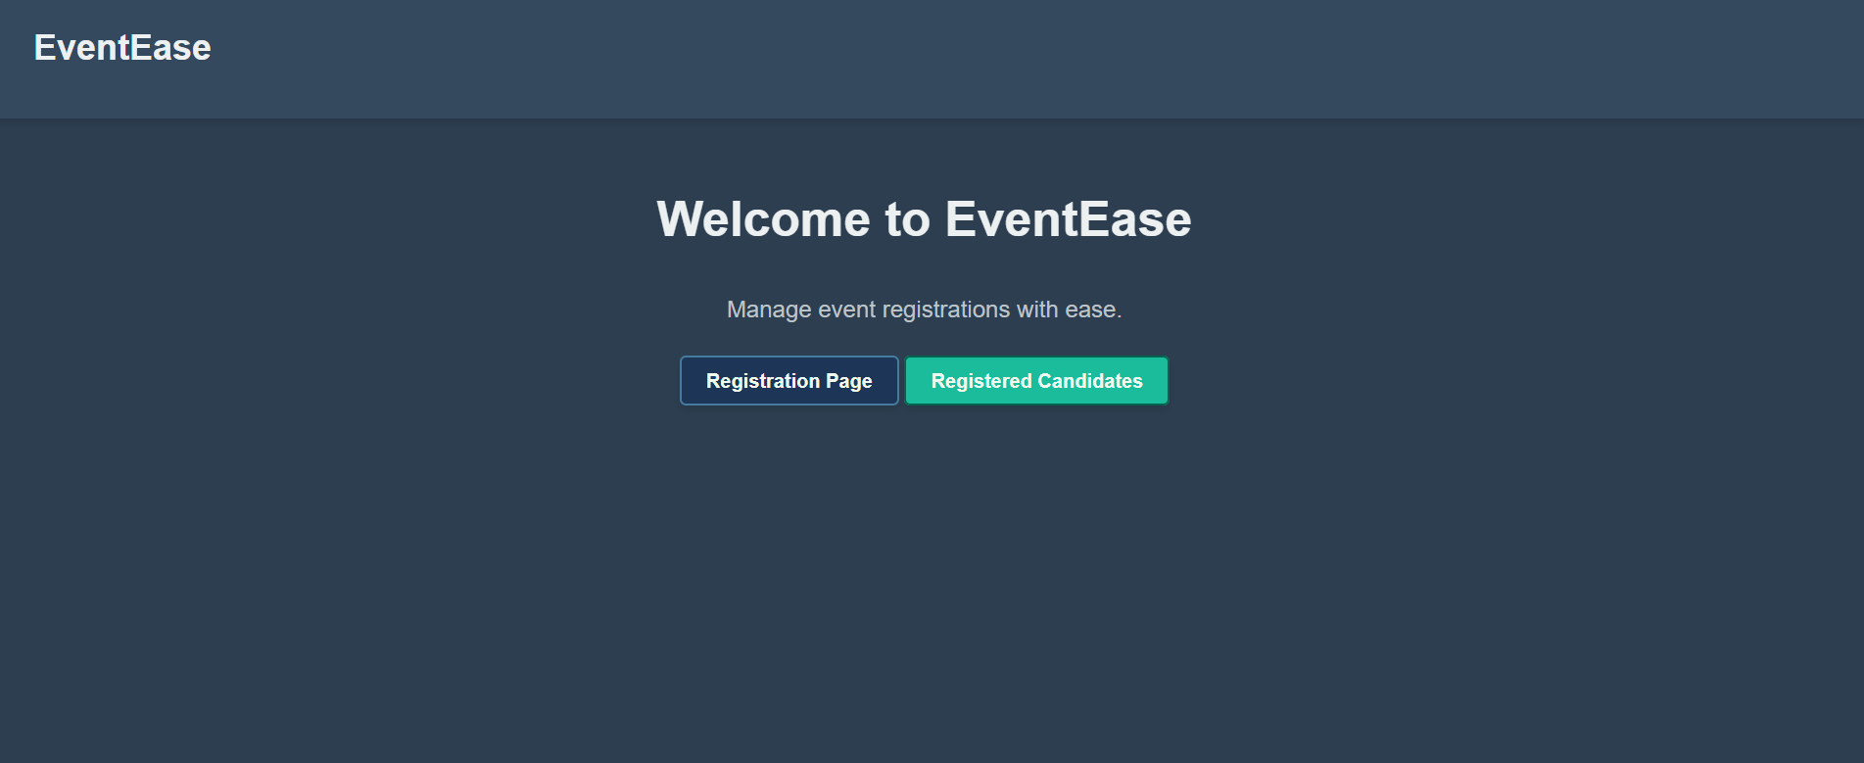
Project Highlights

Slide 14


Slide 15
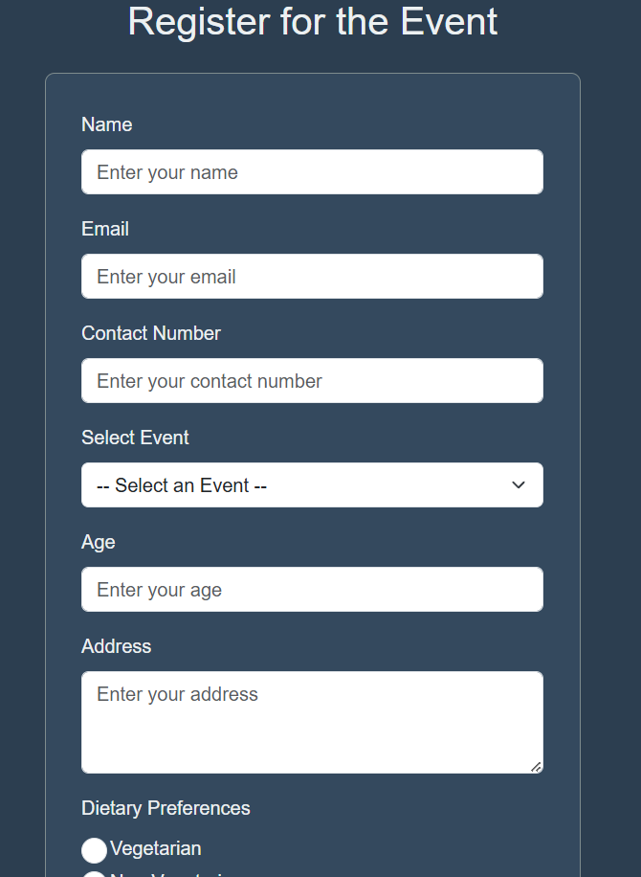

Slide 16
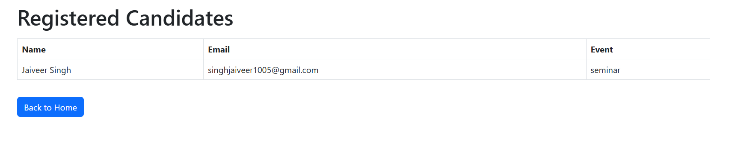

Slide 17
Conclusion
Teamwork and Learning

Slide 18


